Slide 1
Specific patterns were only allowed to be worn by nobility, such as wider stripes or wavy lines of greater width indicated high rank. This was a way people could determine the royal lineage of a person by the clothing he or she was wearing.

Slide 2
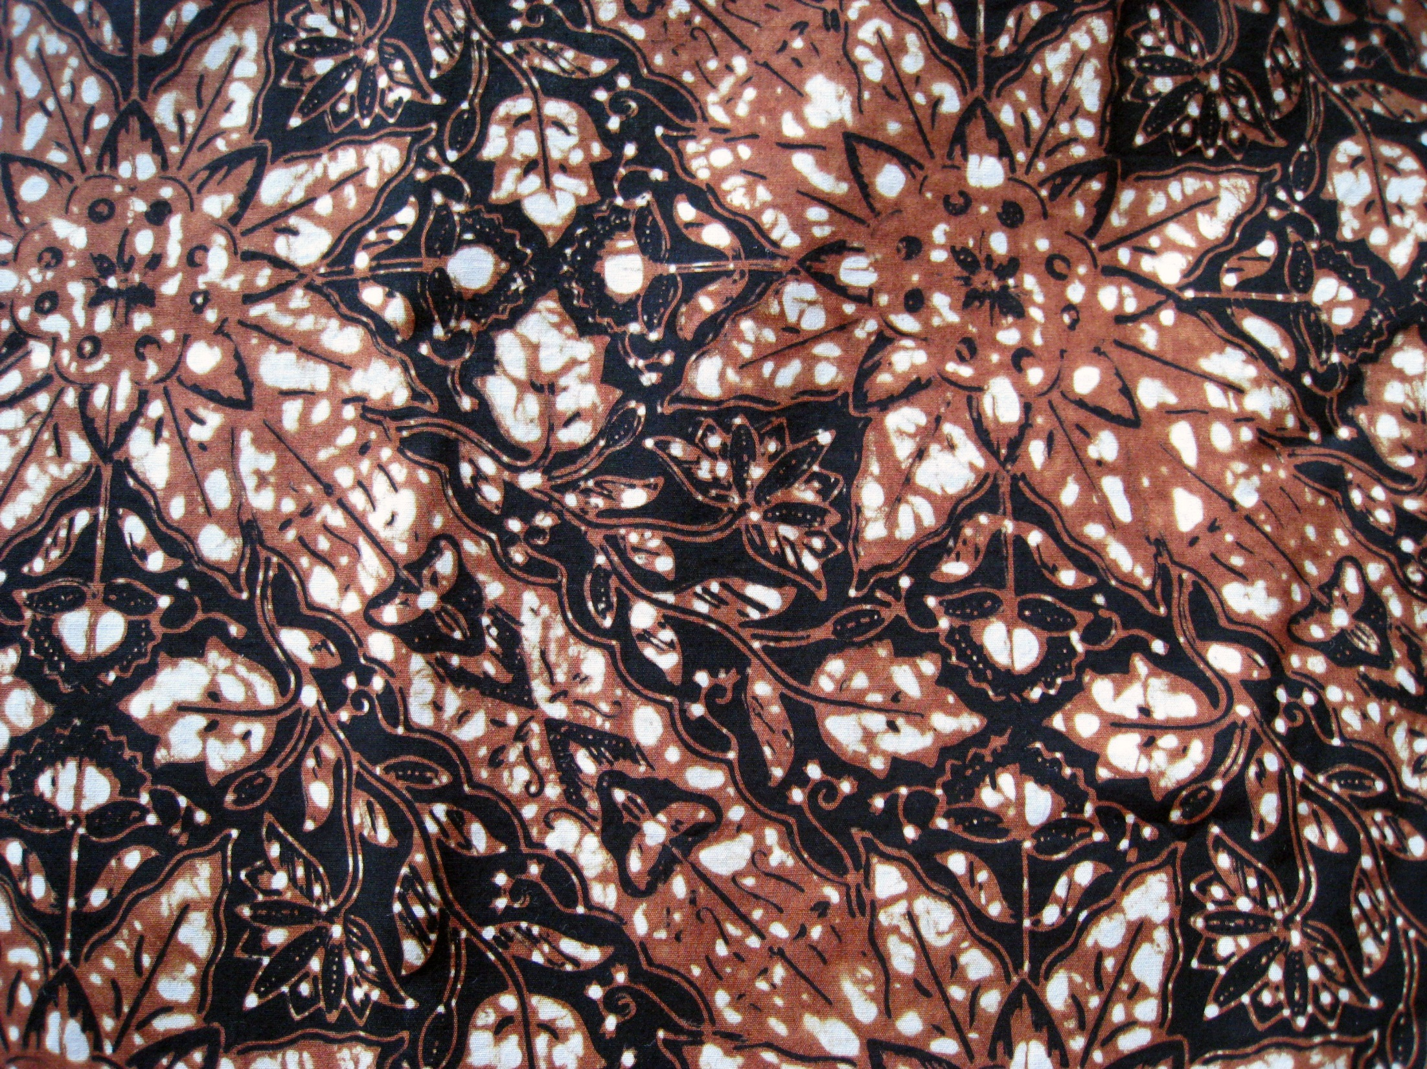
Where is Batik found?
Batik or fabrics with the traditional batik patterns are found in:
Indonesia, Malaysia, Japan, China India, Sri Lanka, Egypt, Nigeria, and Singapore
Different regions of Indonesia have unique or original patterns that usually focus on themes from everyday lives. They tie in patterns such as nature, flowers, animals and people.

Slide 3
The type of dyeing which is used in Batik is called a wax resist. This technique in fabric is an ancient art form. This type of art has been discovered to trace all the way back to Egypt in the 4th century BC. Then is was used to wrap mummies, linen was soaked in wax, and scratched using a sharp tool. The technique was also practiced in various other parts of the world as well.

Slide 5
Melted wax is applied to cloth before being dipped in dye. It is very common for artists to use a mixture of beeswax and paraffin wax. This is because the beeswax has the ability to hold to the fabric and the paraffin wax allows cracking, which is an important characteristic of batik.
Wherever the wax has seeped into the fabric, the dye will not penetrate. After waxing and dyeing several times, the fabric is ironed between paper towels to absorb the wax and reveal the colors and crinkle lines that give batik its character.

Slide 6
The next 3 examples are actually from past students here at MHS:

Slide 7
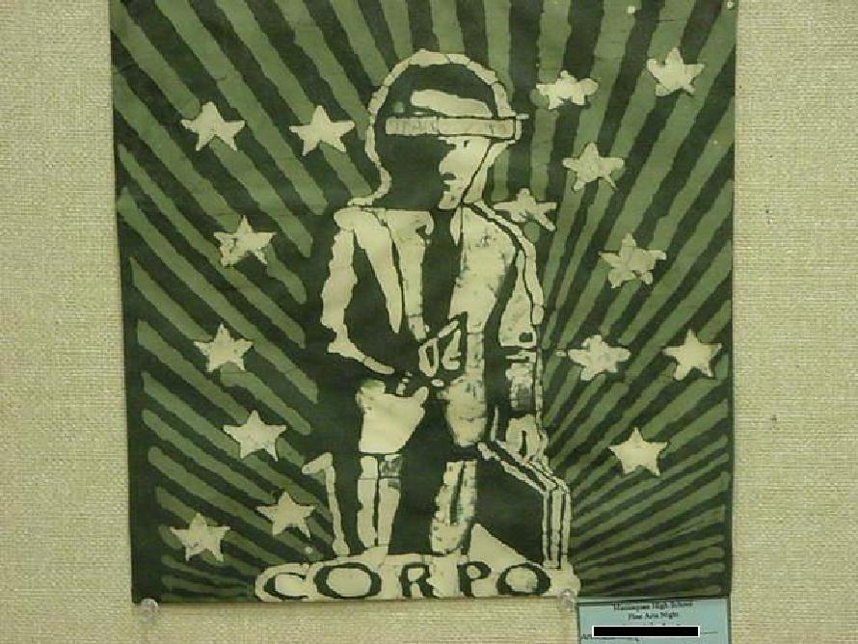

Slide 10
Here are some other really nice examples that I found on the internet

Slide 11
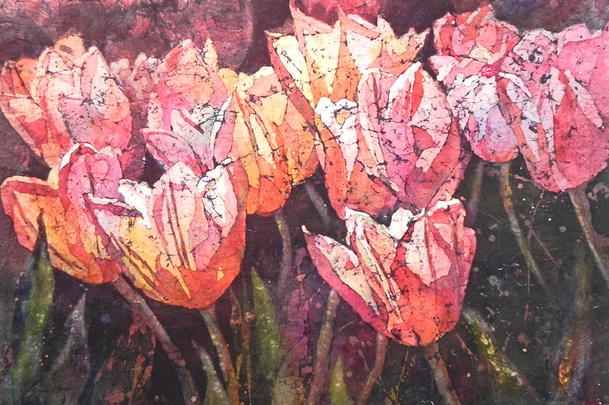

Slide 12
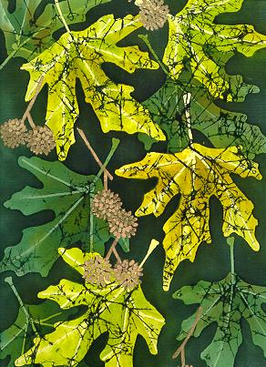

Slide 13
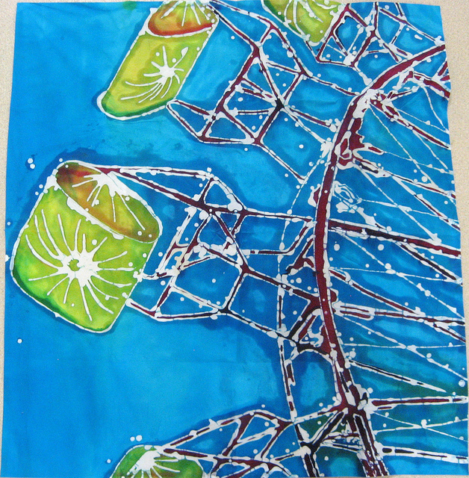

Slide 14
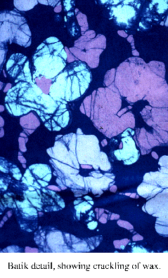

Slide 15
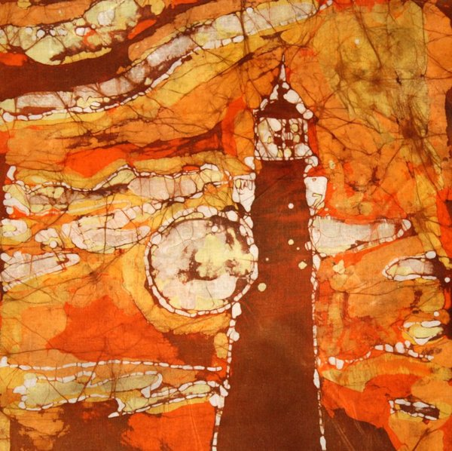

Slide 16
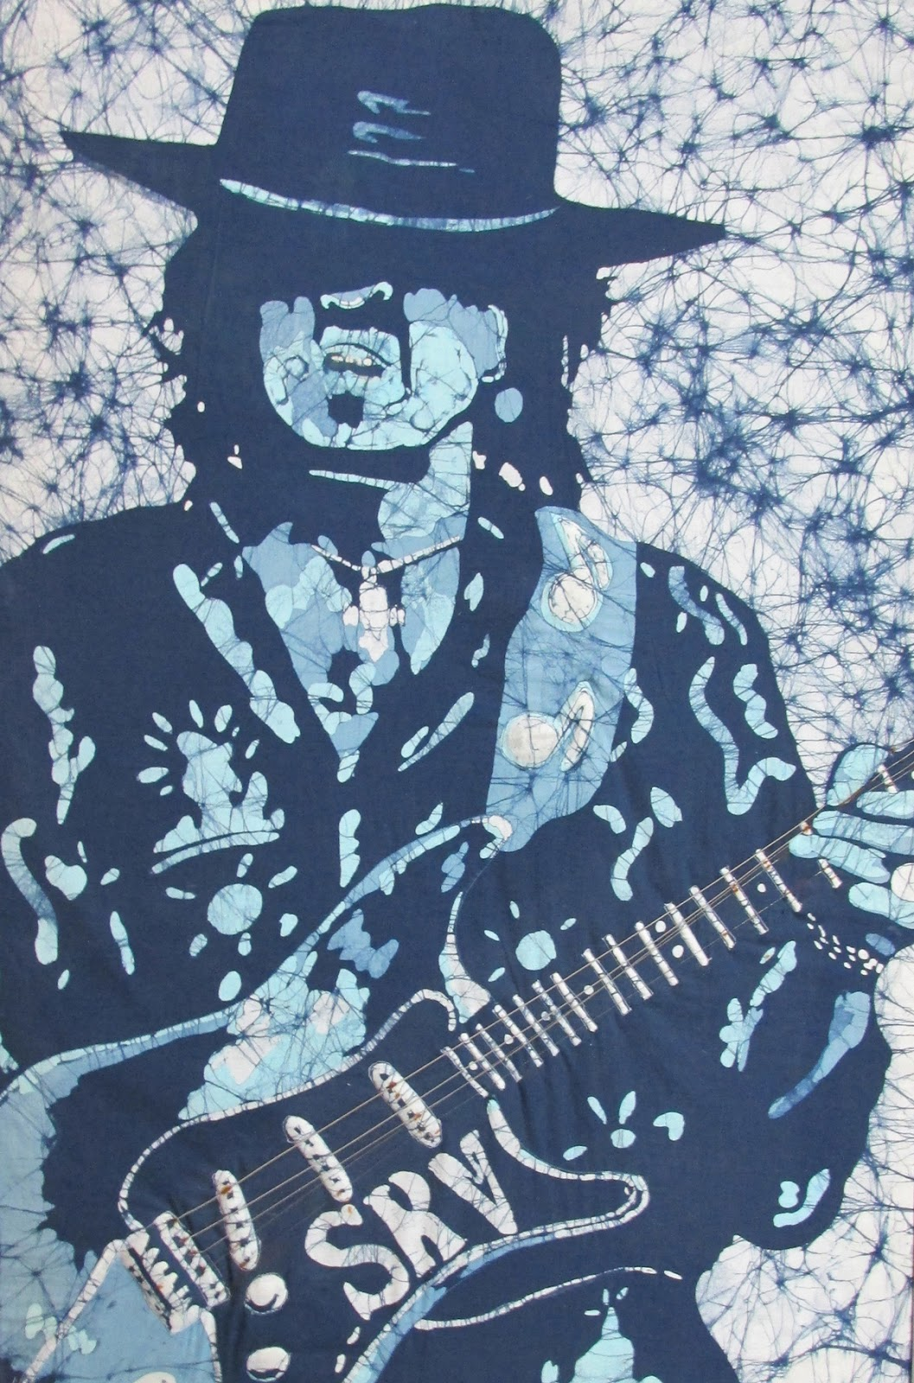

Slide 17
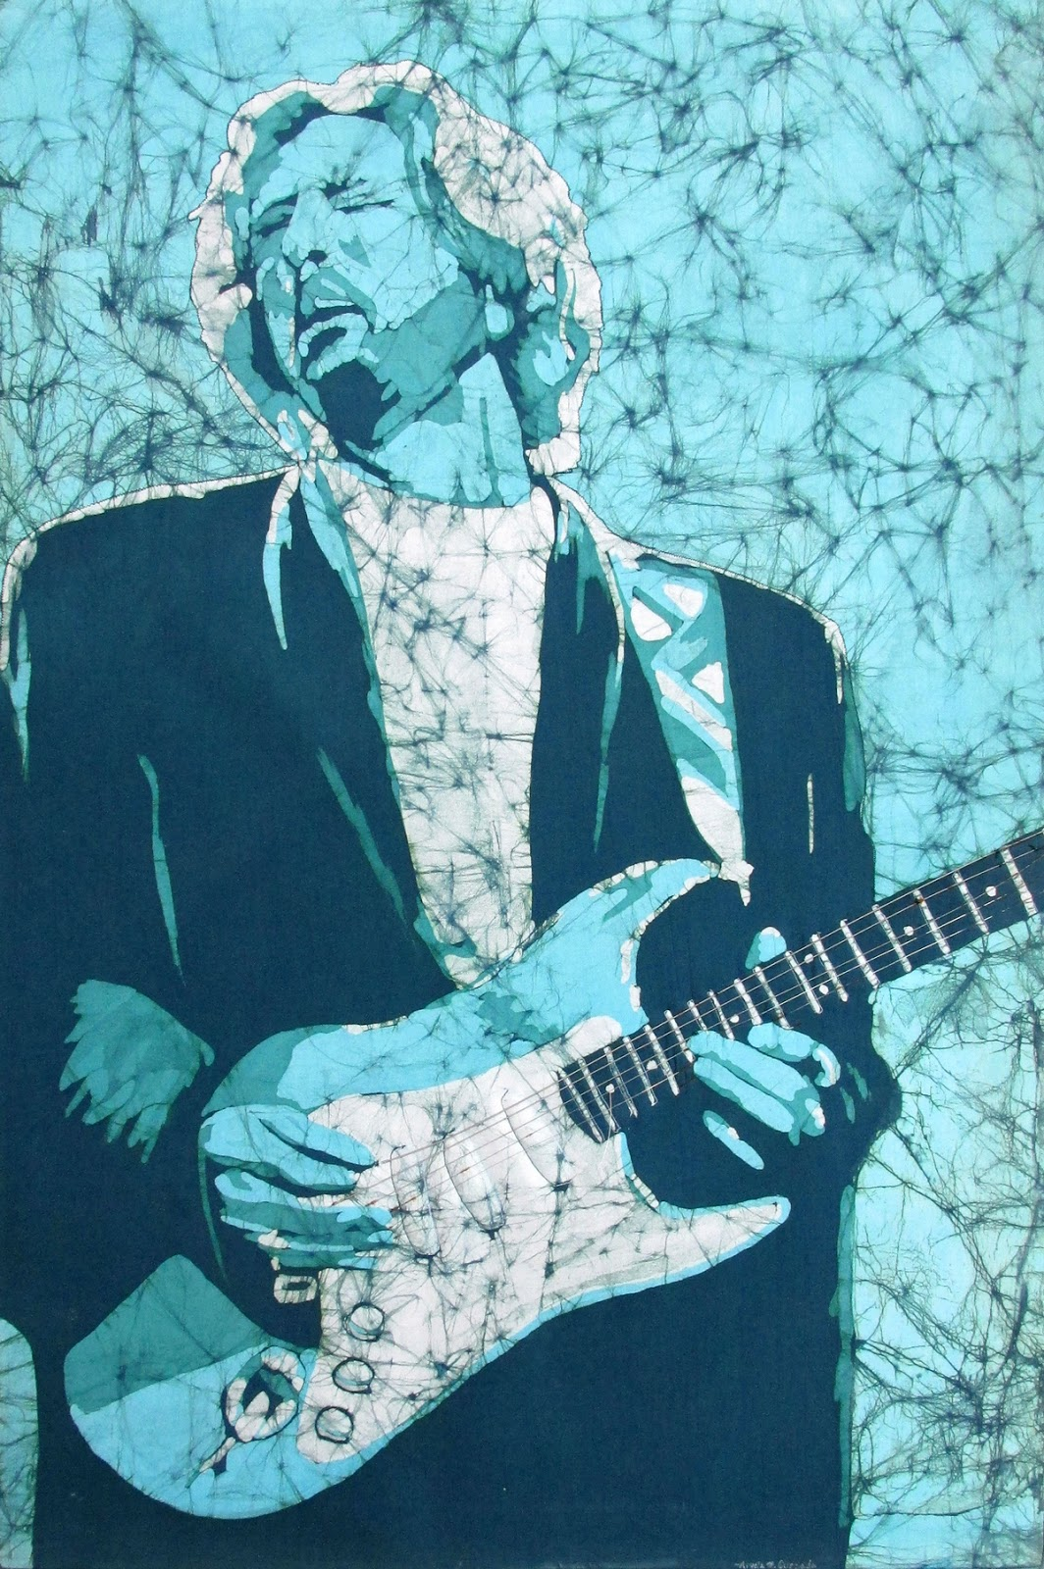

Slide 18
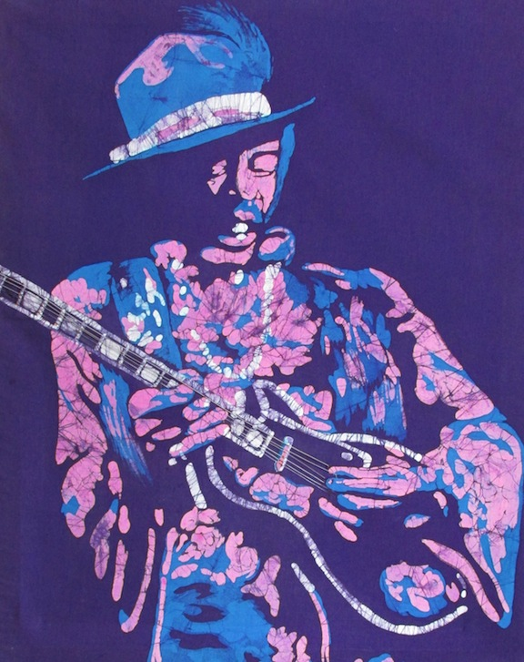

Slide 19
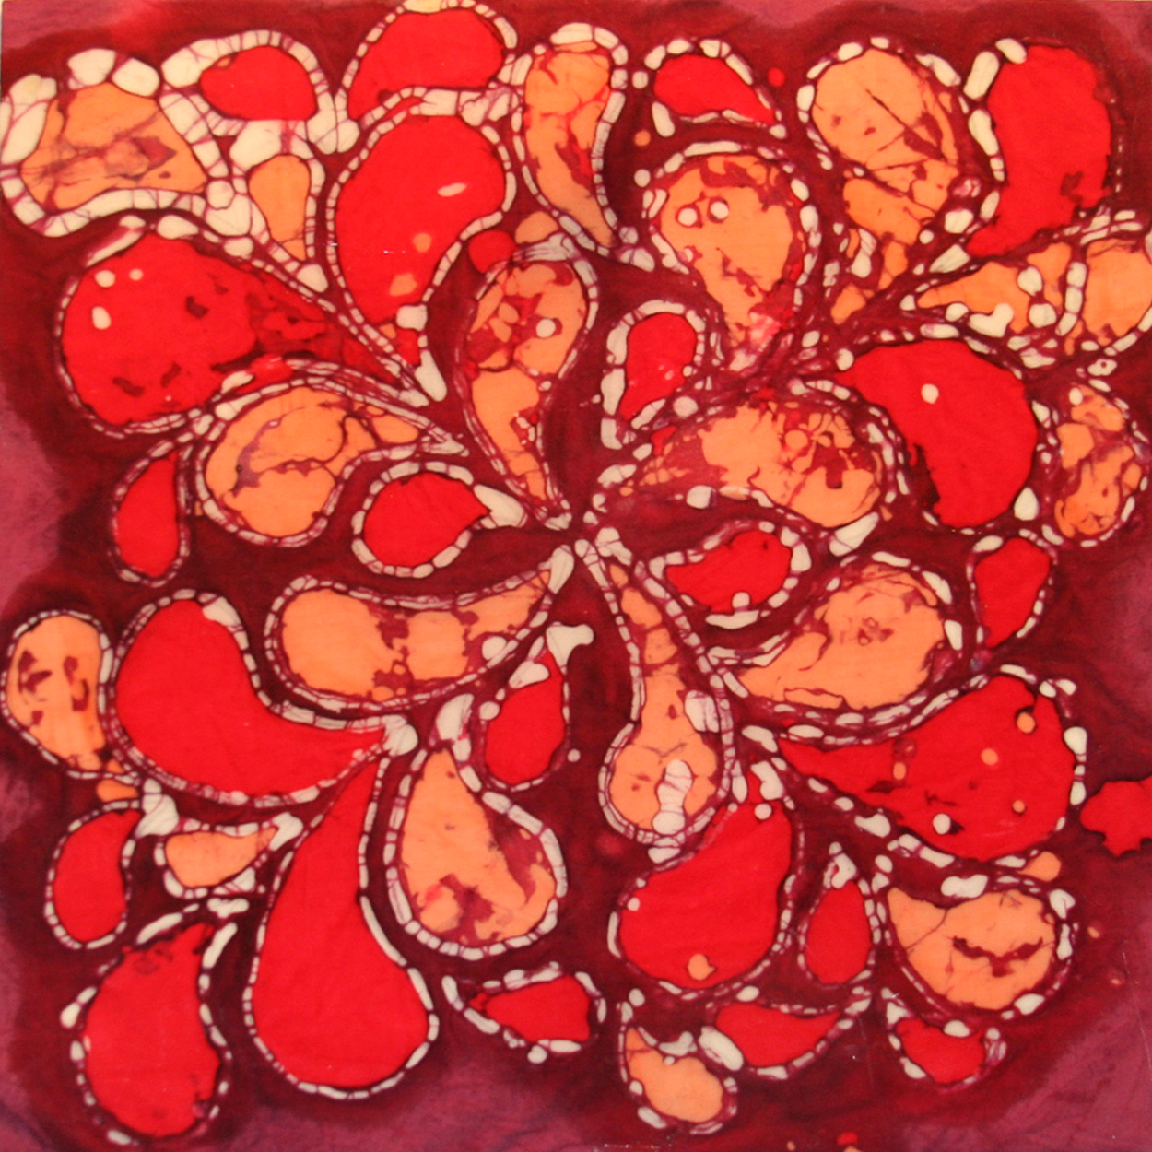

Slide 20
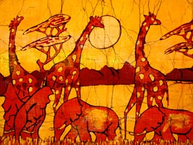

Slide 21
Notice the color scheme on all of the examples, all of the colors are analogous and/or build off of each other
Your batik will be the same way, so it is extremely important to plan out your colors ahead of time

